Slide 1
ASI Student Research &
Travel Reimbursement
Document and form submission
Oﬃce of Student Research
osr@csusb.edu
CE 357

Slide 2
What we will cover
Guidelines
Receipt Itemizations
Lodging/Hotel Itemizations
Transportation
Airfare
Conference Registration
Non-allowable Expenses
Reimbursement Timeline

Slide 3
Guidelines
Students MUST apply for funds prior to travel.
Applications for retroactive reimbursement will not be accepted.
Students must complete the Travel Liability Waiver.
Please ensure that you have gathered all of the following information prior to completing this form:
1) Grant award letter identifying the award amount
2) Conference conﬁrmation email or letter
3) Travel Dates
4) Travel information
a) Receipt of all travel expenses, including itemizations.
All expense receipts should be submitted within
ﬁve business days
following your travel dates.
Reports and receipts not submitted within 30 days
following your travel will not be reimbursed.

Slide 4
Receipt Itemization
To be reimbursed for travel expenses, you will need to submit a valid receipt that MUST indicate payment was received and includes:
❏
Vendor name
- whom services were obtained from
❏
Date
- confirm expenses occurred during the trip
❏
Itemization of Charges
- taxes, fees, payment, etc
❏
Proof of payment
- indicate charged, show a credit, or marked
balance paid in full (must include company representative signature and printed name Receipts should not be altered). A PAID stamp is not acceptable nor is a bank statement.
❏
Mileage
- map showing distance traveled to and from conference
ONLY; gas receipts are not acceptable. If traveling with personal car, please provide license plate number, and insurance.
❏ Keep original receipts until fully approved/processed. Make sure all scanned/emailed receipts are clear and legible.
❏ Please Note: You may screenshot or copy/paste small receipts onto an 8 ½ x 11 paper or pdf file.

Slide 5
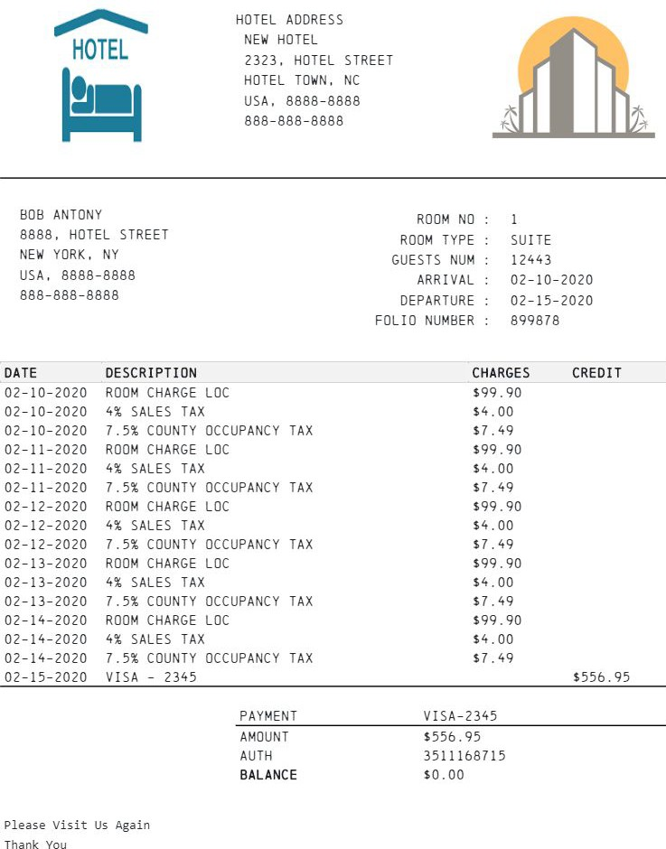
Lodging/Hotel Itemization
It is expected that students share their hotel room with
fellow presenters, when possible. For domestic lodging
there is a maximum of
$275.00 per night (excluding
taxes).
If invoice has payee listed as name other than applicant, please submit proof of payment to the individual listed on invoice (include date of transaction and vendor used to perform payment).
Invoice or receipt with itemizations
❏ vendor name
❏ logo
❏ arrival/departure date
❏ itemization of ALL charges
❏ proof of balance paid in full

Slide 6
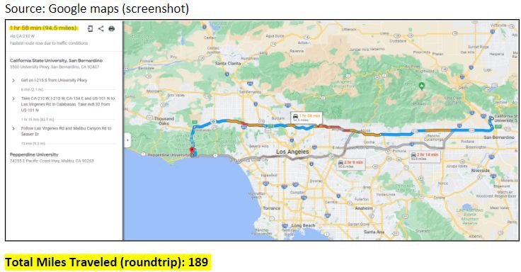
Transportation
Airfare or mileage (travel by car)
Mileage is reimbursed at $0.54 per mile (car). A map showing mileage traveled must be attached if using personal car for travel to and from conference destination. Gas is considered a non-allowable expense, please DO NOT submit gas receipts.
Mileage is determined from the campus to the destination, unless student lives closer to the destination. Each destination should be listed separately by name.
If the student is unable to travel using the least expensive option, the committee must pre-approve the travel arrangements prior to the trip.

Slide 7
Airfare Itinerary
If requesting airfare reimbursement please provide an itinerary of ALL ﬂight travel throughout your trip.
Must include:
❏
Vendor name
(ex: American Airlines, Delta, Alaska
Airlines, etc.)
❏ Arrival and departure locations/dates (include any layovers or transfers)
❏
❏
Passenger name should match applicant name
Proof of payment
Please note travel insurance and baggage fees are non-allowable expenses per SRT guidelines and will not be reimbursed.

Slide 8
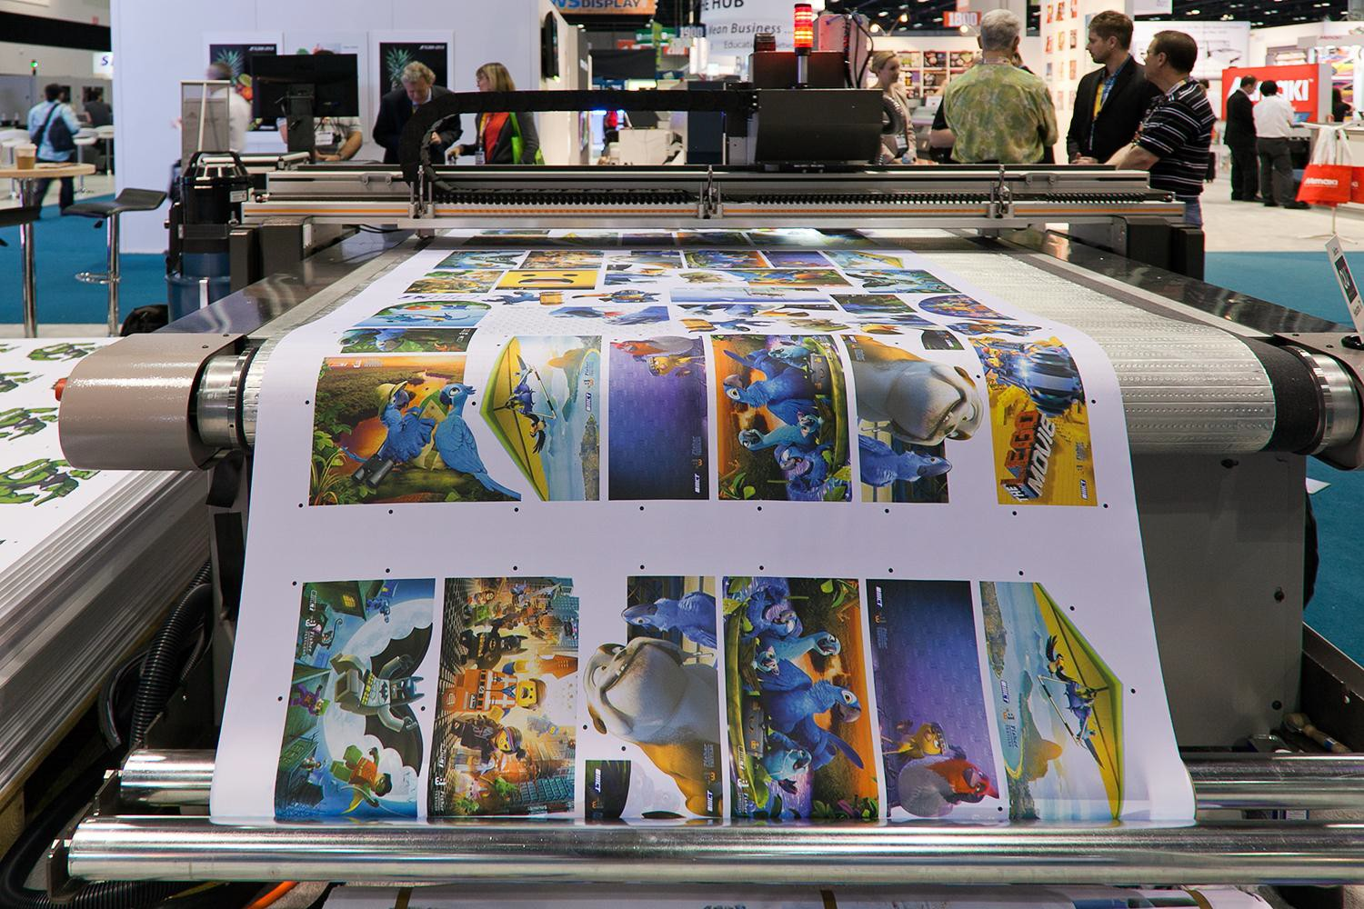
Conference Registration & Printing and Copy Services
Students attending and not presenting at a conference will be funded the conference registration fees ONLY (does not include membership fees).
Printing and Copy Services are funded at
$0.04 per page.

Slide 9
Expenses that are
not funded include:
Food
Any equipment (laptops, computers, etc.)
Association or organizational memberships, software, or subscriptions to journals.
Internet access, movies, room service, gym, fees for ﬂight changes or upgrades of any sort.
Single room occupancy (It is expected that students will share rooms – this should be indicated with the “hotel” information. If mitigating circumstances for single occupancy exist, please contact the OSR for prior approval.
Accommodations at the conference hotel (if less expensive hotels are nearby)
Child care
Mileage to and from the airport
The cost of gasoline (This is already included in the per mile reimbursement)
The cost of a rental car
Phone cards
Passports/Visa Fees
Transportation within destination

Slide 10
Reimbursement Timeline
Step 1: Documentation Review
All submitted receipts will be reviewed to ensure that they are within the allowable expenses.
Receipts will be checked for validity and proof of payment.
If for any reason, the receipts are not valid, you will be contacted by the OSR to resubmit them.
Step 2: Concur Travel Expense Processing
Once all documents are reviewed and approved, a Travel Expense will be entered into Concur on the student’s behalf.
Step 3: Travel Expenses Review & Payment Release
The Travel Oﬃce will be notiﬁed of the submitted expense and they will begin reviewing.
The reimbursement check will be mailed once completed.
Please note: Processing times are longer than usual during this time. Please allow at least 6-8 weeks to receive your reimbursement once you’ve been notiﬁed that the expense has been submitted.

Slide 11
If this is your ﬁrst time submitting a grant proposal, you are encouraged to meet with a Coyote Research Ambassador.
Email osr@csusb.edu
Appointments are available upon request
Please visit our website www.csusb.edu/student-research or ﬁll out a CRA advising request using the link → CRA Advising Request
If you have any other questions or would like further assistance with your application before submitting please contact us and we’ll be happy to
assist you.
Phone Number (909) 537-3728
Location
College of Education-357

