Slide 1
Graduation & Retention Specialists
Working Towards 2025

Slide 2
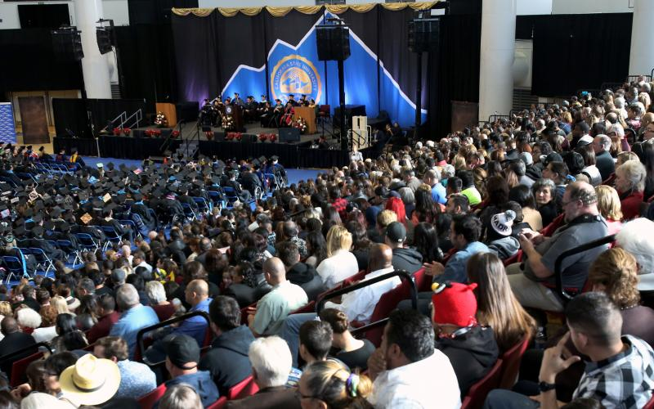
Graduation Retention Specialist (GRS)
Newly created positions in late Spring 2017 to support the goals of GI 2025
Utilize targeted campaigns and proactive advising to supplement the work already being done by faculty and professional advisors
Report to the Dean of Undergraduate Studies, but work within a designated College and their Student Success Teams
College of Arts and Letters - Judith Osorio
Jack H. Brown College of Business and Public Administration - Mandy Thind
College of Natural Sciences - Kristen Rogers
College of Social and Behavioral Sciences - Shannon Long

Slide 3
Freshman Cohort Retention & Golden Four
On a quarterly basis, contact the students in the First Time Freshman (FTF) cohort to show them where to find their registration appointment and holds, encourage them to register, and direct them to the advising center in their college. Additionally, encourage the students in this cohort to complete the Golden Four in their first year.
Desired Results:
Increase in quarterly and yearly retention for FTF
Encourage students to complete 45 units each academic year
Increase in four year graduation rates
IR data shows that students who complete Golden Four in first year have a higher chance of graduating in four years

Slide 4
Freshman Cohort Retention
2017 FTF Retention
 | Contacted Before Priority Registration |  | Contacted After Priority Registration |  | Contacted the Week Before Classes Began
 | Students Contacted | Students Registered | Students Contacted | Students Registered | Students Contacted | Students Registered
Winter 2018 | 2822 | 2696 | 142 | 61 | 70 | 10
Spring 2018 | 2196 | 1987 | 205 | 99 | 112 | 25

Slide 5
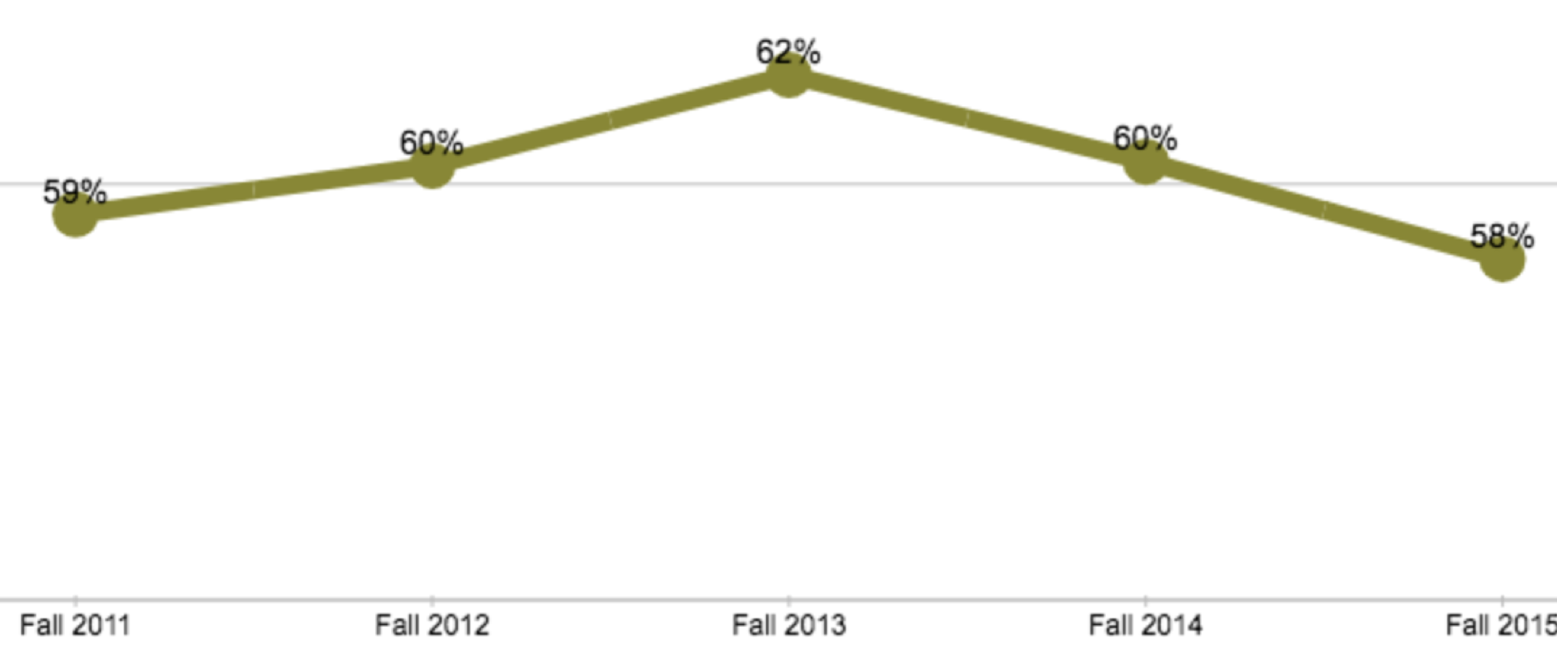
Golden Four
Data from IR: Completion of Golden Four in Two Years

Slide 6
Sophomore Cohort
Annually, contact second year students who are on track for graduation in four years to complete an academic plan to stay on track. Also, contact all sophomores quarterly who have not registered after priority registration to encourage registration during open enrollment and to visit their college’s advising center.
Desired Result:
Second year students will continue to stay on track with encouragement and information from advising centers
There will be an increase in retention for the sophomore cohorts
Encourage students to complete 45 units each academic year

Slide 7
Sophomore Cohort
2016 FTF
 |  | Contacted for Retention Purposes
 | Students on Track at the End of Quarter | Students Emailed | Students Registered
Fall 2017 | 539 | 36 | 13
Winter 2018 | 615 | 17 | 11

Slide 8
Repeats and Incompletes
On a quarterly basis, contact students who are repeating courses to provide with resources, information about Grade Forgiveness policies, and to invite them to their college advising center. Also, contact students with incompletes to remind them of the deadline to complete the requirements for a letter grade.
Desired Result:
Higher passing rates in repeated courses
Increase in the amount of students who successfully complete classes with Incompletes
Ensure that students are aware of policies that could help them increase their overall GPA

Slide 9
Repeats and Incompletes
Quarter | Students Emailed for Course Repeats | Students Emailed for Incomplete Contracts
Fall 2017 | 2300 | 492
Winter 2018 | 2523 | 677
Spring 2018 | 2458 | 829

Slide 10
Senior Cohorts
Twice a year, in the month preceding the Spring and Fall graduation filing deadlines, students from the current senior cohort and students with 135 or more units from previous cohorts are invited to attend a Grad Check Workshop.
Workshop Presentation covers:
Graduation vs. Commencement
Degree requirements: GE, Major, Minor, Unit & GPA requirements
Graduation Requirement Check - fees, deadlines & when to file
Presentation is followed by development of individual Graduation Plans.
Desired Result:
Significant increase in the number of Graduation Checks filed on time and filed for the correct graduation term.

Slide 11
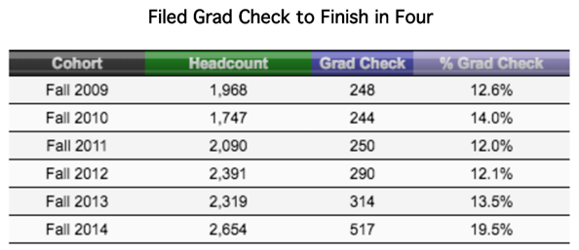
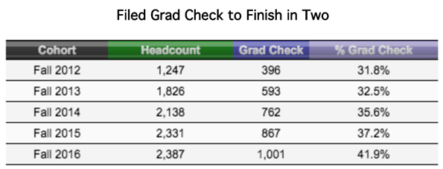
Senior Cohorts

Slide 12
Other Campaigns:
Graduation Initiative Grant (GIG)
GIG pays tuition for graduating students to attend Summer courses and provides an opportunity to ensure students are meeting all remaining requirements.
Students must be able to graduate by the end of the Summer term, be in good academic standing, and have a Grad Check on file in order to qualify.
Desired Results:
Allow students to graduate a quarter earlier than they would have
Increase graduation rate for current academic year

Slide 13
Other Campaigns:
Junior Cohorts
A few weeks before the start of the Fall term each year, contact the incoming transfer cohort with a welcome email to give important upcoming dates and to encourage them to go to the advising center for their college. Additionally, in the Spring term each year, contact students in the junior cohorts with a borderline GPA (2.0-2.3) to provide with resources.
Desired Results:
Help new transfer students stay on track for two year graduation
Identify and intervene with students who are at risk of being put on academic probation

Slide 14
Other Campaigns:
Excessive Units
Contact students with 170-215 units who are not on track to discuss and create a Graduation Plan.
Review all students with excessive units and determine those who will receive holds
Place holds after census to meet with student and create a plan (MyCap)
Desired Result:
Students with excessive units will successfully follow their plan made with GRS and graduate in a timely manner

Slide 15
Other Campaigns:
Grad Checks Not on Track
Contact students that have filed a Graduation Check for the current term (or upcoming term after priority registration) that have one or more degree requirements incomplete in their PAWS.
Desired Result:
Inform students of needed classes/graduation requirements to ensure they graduate in the quarter they indicated or refile for the appropriate quarter

Slide 16
Conclusion
Campaigns will continue to evolve as we evaluate their effectiveness
Hope to align campaigns with four goals:
Increase the number of units that students register in
Increase the number of completed units
Decrease non-degree applicable units
Increase four-year graduation rates specifically for URM and Pell eligible students

